Slide 1
Software Engineering
(BCSC0009)
Mona Kumari
GLA UNIVERSITY Mathura, Uttar Pradesh, India

Slide 2
Module-I
Introductory Concepts | Introduction of Software Engineering, Software Failures, Program Vs Software, Software Myths
 | Software – Its Characteristics
Process Models | Build & Fix Model, Waterfall Model, Iterative Enhancement Model, Prototyping Model, Sprial Model
 | Agile software Dovelopment Model- Scrum, Sprint, Product Backlog,Sprint Backlog.
Software Requirement Specification | Requirement Engineering, Types of Requirements
 | Feasibility Studies, Requirement Elicitation-Interviews, Brainstroming, FAST, QFD, Use Case
 | Requirement Analysis-DFD
 | Requirement Documentation- Characterstics, Organization of SRS
Software Project Planning & Software Metrics | Project Planning Objectives
 | Size Estimation-LOC, Function Point; Cost Estimation
 | Models-Static, Single Variable Model, Static, Multivariable Models
 | COCOMO

Slide 3
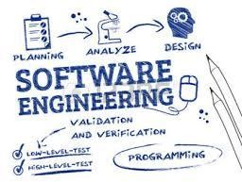
Subject: Software Engineering Subject Code: BCSC0009
2

Slide 4
Course objectives
In this course, students will gain a broad understanding of the discipline of software engineering and its application to the development and management of software systems.
knowledge of basic SW engineering methods and practices, and their appropriate application;
A general understanding of software process models.

Slide 5
An understanding of
The role of project management including planning, scheduling, risk management, etc.
software requirements and the SRS document.
Implementation issues such as modularity and coding standards.
approaches to verification and validation.
some ethical and professional issues.
Development of significant teamwork and project based experience

Slide 6

What is Software?
The product that software professionals build and then support over the long term.
Software encompasses:
(1) instructions (computer
programs) that when executed
provide desired features, function, and performance;
data structures that enable the programs to adequately store and manipulate information and
documentation that describes the operation and use of the programs.
6

Slide 7
What is software?
Computer programs and associated documentation such as requirements, design models and user manuals.
Software products may be developed for a particular customer or may be developed for a general market.
Software products may be
Generic - developed to be sold to a range of different customers e.g. PC software such as Excel or Word.
Bespoke (custom) - developed for a single customer according to their specification.
New software can be created by developing new programs, configuring generic software systems or reusing existing software.

Slide 8
What is software engineering?
Software engineering is an engineering discipline that is concerned with all aspects of software production.
Software engineers should adopt a systematic and organised approach to their work and use appropriate tools and techniques depending on the problem to be solved, the development constraints and the resources available.

Slide 9
Software Engineering Definition
The seminal definition:
[Software engineering is] the establishment and use of sound engineering principles in order to obtain economically software that is reliable and works efficiently on real machines.
The IIEEE definition:
Software Engineering: (1) The application of a systematic, disciplined, quantifiable approach to the development, operation, and maintenance of software; that is, the application of engineering to software. (2) The study of approaches as in (1).

Slide 10
Importance of Software Engineering
More and more, individuals and society rely on advanced software systems. We need to be able to produce reliable and trustworthy systems economically and quickly.
It is usually cheaper, in the long run, to use software engineering methods and techniques for software systems rather than just write the programs as if it was a personal programming project.
For most types of system, the majority of costs are the costs of changing the software after it has gone into use.

Slide 11
What are the attributes of good software?
The software should deliver the required functionality and performance to the user and should be maintainable, dependable and acceptable.
Maintainability
Software must evolve to meet changing needs;
Dependability
Software must be trustworthy;
Efficiency
Software should not make wasteful use of system resources;
Acceptability
Software must accepted by the users for which it was designed. This means it must be understandable, usable and compatible with other systems.

Slide 12
What are the key challenges facing software engineering?
Heterogeneity, delivery and trust.
Heterogeneity
Developing techniques for building software that can cope with heterogeneous platforms and execution environments;
Delivery
Developing techniques that lead to faster delivery of software;
Trust
Developing techniques that demonstrate that software can be trusted by its users.

Slide 13
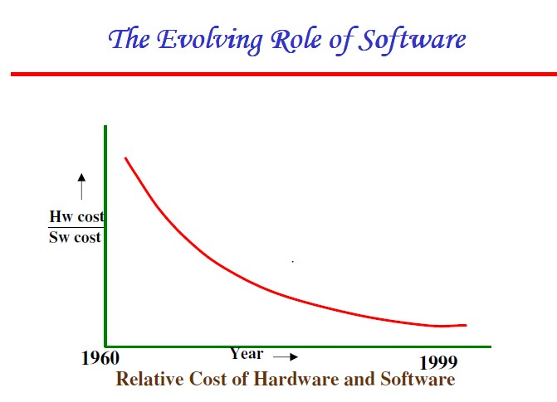
2
2

Slide 14
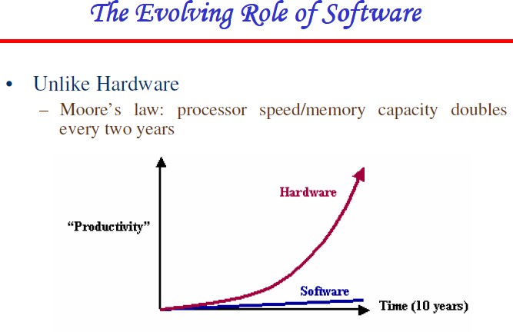
2
3

Slide 15
The Evolving Role of Software
The role of computer software has undergone significant change over a time span of little more than 50 years.
Reason: Improvement of hardware performance
Naisbitt predicted a transformation from an industrial society to information society.
The lone programmer has been replaced by a team of software experts -> importance of applying the software engineering principles.

Slide 16
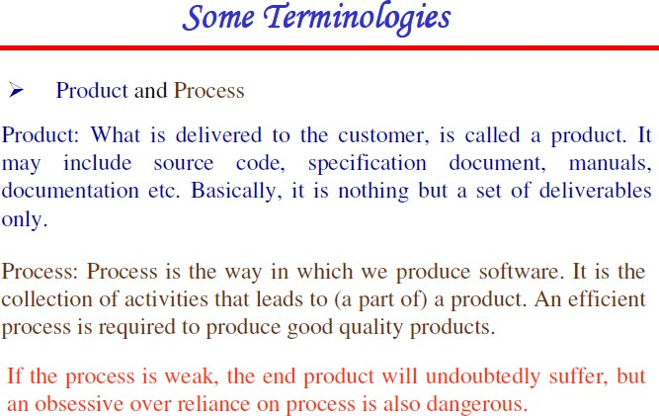

Slide 17
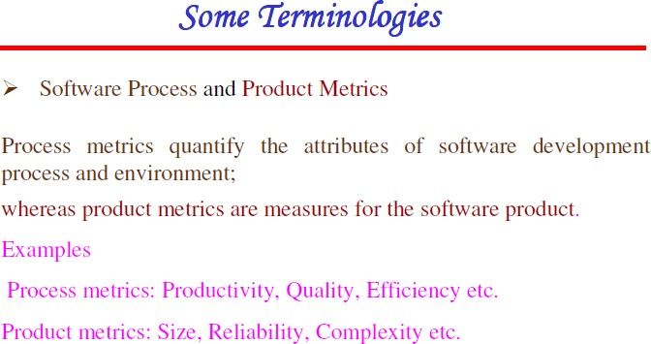

Slide 18
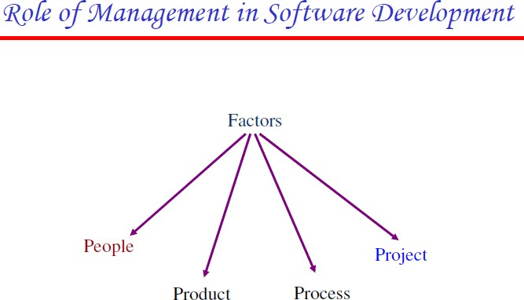

Slide 19

Software Myths

Slide 20
Management’s Myths
Myth(1)
The available standards and procedures for software are enough.
Myth(2)
Each organization feel that they have state-of-art software development tools since they have latest computer.
Myth(3)
Adding more programmers when the work is behind schedule can catch up.
Myth(4)
Outsourcing the software project to third party, we can relax and let that party build it.

Slide 21
Customer’s Myths
Myth(1)
General statement of objective is enough to begin writing
programs, the details can be filled in later.
Myth(2)
Software is easy to change because software is flexible

Slide 22
Developer’s Myths
Myth(1)
Once the program is written, the job has been done.
Myth(2)
Until the program is running, there is no way of assessing the quality.
Myth(3)
The only deliverable work product is the working program
Myth(4)
Software Engineering creates voluminous and unnecessary documentation and invariably slows down software development.

Slide 23
Software Characteristics
Software does not wear out
(Failure Curve for Hardware)
Burn-in phase
Wear out phase
Failure Intensity
Useful life phase
Time

Slide 24
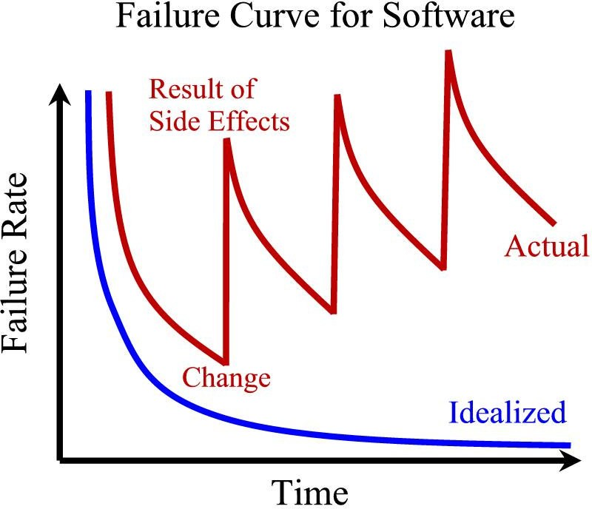
Software is not manufactured
Reusability of components
Software is flexible

